Slide 1
Software Testing
SDLC / STLC

Slide 2
Software Development Life Cycle
When humans first started writing software, they had little idea how to do it.
This started the field of software engineering.
One of the outcomes was the software development life cycle

Slide 3
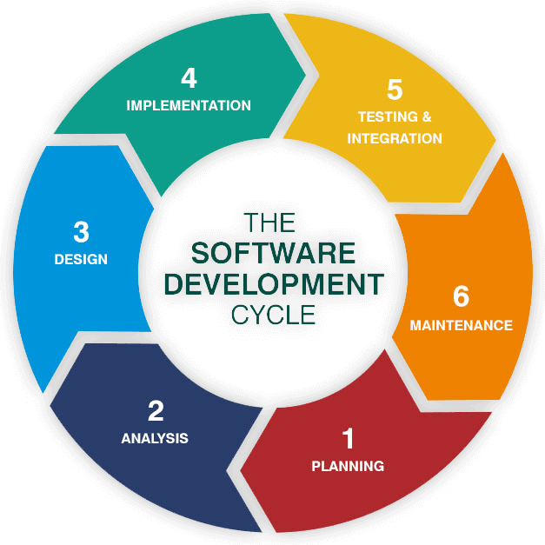
SDLC

Slide 4
SDLC Phases
Planning - plan the entire project
Analysis – understand requirements to map software onto that set of requirements
Design – design a software solution to meet the reqirements
Implementation – build the software
Testing and Integration – install into target environment and test
Maintenance – adapt software to changing requirements and environment

Slide 5
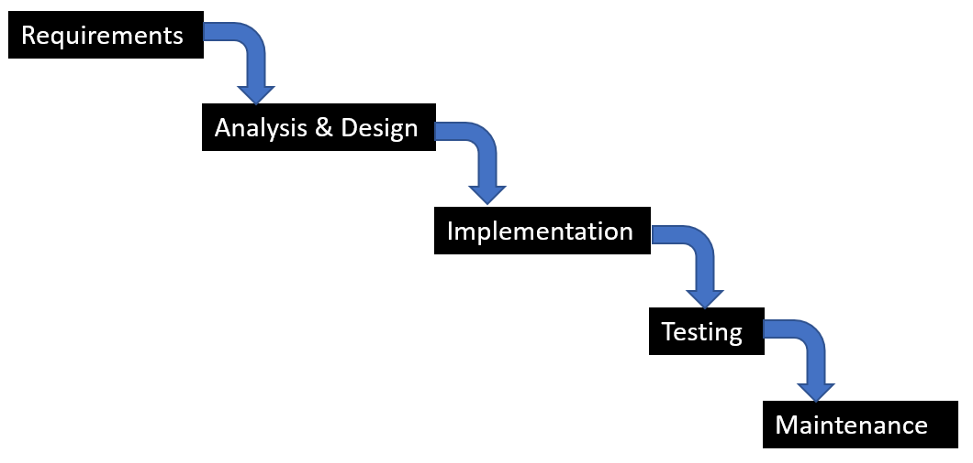
Waterfall Model

Slide 6
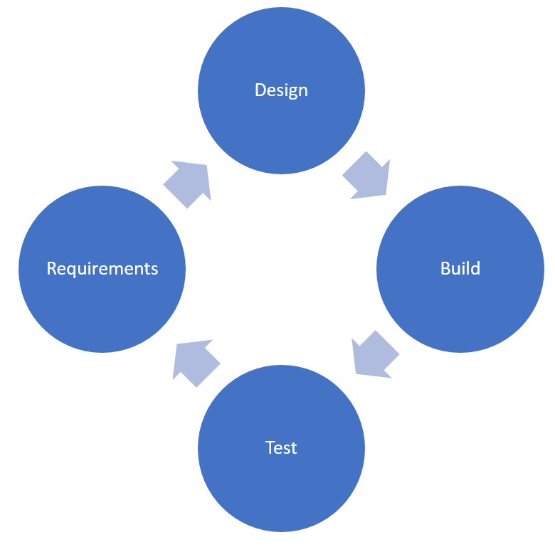
Iterative Model

Slide 7
Agile Models
Respond to change quickly
Changing requirements are not a disaster
Phases can happen simultaneously
Design can start once some requirements are finalized
Implementation can start once some design is finished
Test design can start once design is complete
Testing can start as soon as some coding is done
When a problem is found
Go back and fix it!

Slide 8
Testing in the SDLC
You can test
During requirements – test plan
During design – unit test design
During implementation – unit test implementation
During testing
During Delivery – acceptance tests
During maintenance – regression testing and testing new features

Slide 9
Incremental Development
The core of the system is built
Other parts are constructed and added into the core
Testing is done as new components are built and integrated into the whole

Slide 10
Continuous Integration
Working software is kept in a repository
Developers
Check it out to add features or fix bugs
Test it to make sure it is bug-free
Push it to the repository
The goal is to make sure that the code in the repository is bug-free

Slide 11
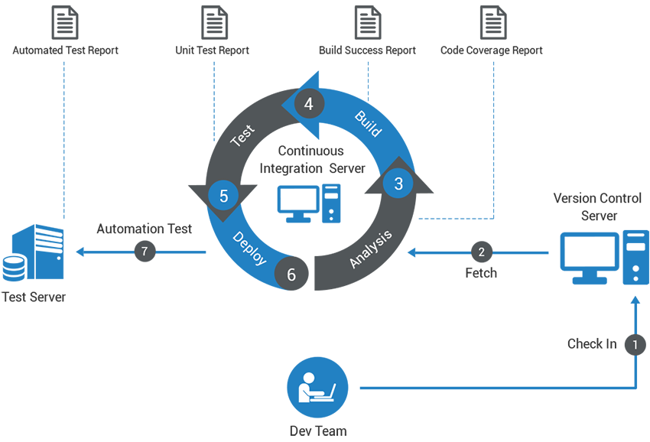
Continuous Integration

Slide 12
Test Driven Development
writes the tests first and then the code to be tested
test team usually gets together with the developers and
agrees on functions or classes and what they should do
advantage of test driven development is that there are no surprises for the developers
can be used as part of continuous integration.

Slide 13
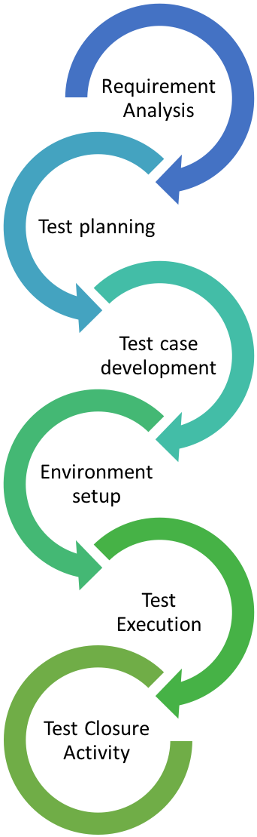
The Software Testing Life Cycle

Slide 14
STLC Benefits
The benefits of using the STLC include:
It provides a guide for the testing process, increasing efficiency and consistency,
It clearly defines the expectations of each part of the project,
It can provide time constraints on the testing,
Ensures that software meets requirements before more software is developed,
Ensures that all project requirements are met.

Slide 15
STLC Phases
Requirements Analysis -- requirements are examined to identify their testable aspects
Entry: A set of requirements and acceptance criteria
Exit: Requirements traceability matrix and an automation feasibility report
Test Planning -- produces the test plan document
Entry: the requirements analysis and requirements test matrix,
Exit: an approved test plan.
Test Case Development -- the actual test cases are created
Entry: an approved test plan.
Exit: approved test cases, test data, and automation scripts
Test Environment Setup -- the test environment is set up
Entry: system design and project architecture.
Exit: a functional test environment.
Test Execution -- tests are deployed to the testing environment and executed
Entry: all of the exit criteria from the previous steps.
Exit: the tests have been performed and test reports generated
Test Cycle Closure -- results in a report which summarizes the results of the tests
Entry: test results and reports.
Exit: test closure report.

Slide 16
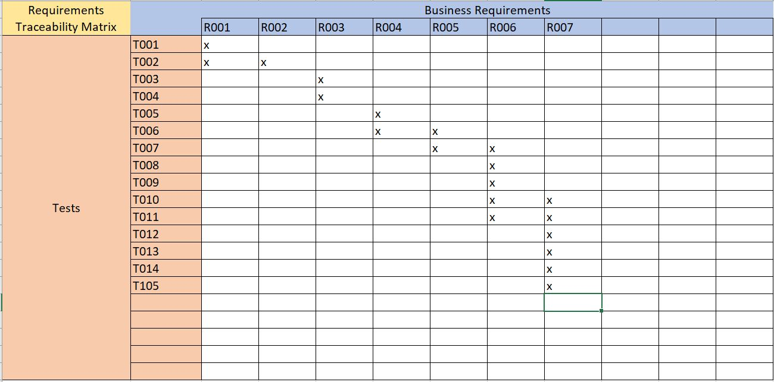
Requirements Traceability Matrix

